Slide 1
Subject | Life skills
Grade | 2 year 1
Term | 3

Slide 2
TABLE OF CONTENT

Slide 3
LESSON PLAN CONTENT
Week 1 -3 | TRANSPORT
Week 4-5 | ROAD/TRAFFIC SAFETY
Week 6-7 | PEOPLE WHO HELP US IN OUR COMMUNITY
Week 8-9 | FRUITS AND VEGETABLES

Slide 4
LESSON OBJECTIVES
Guide and support learners to achieve their full physical, intellectual, personal, emotional and social potential.
Teach learners to exercise their constitutional rights and responsibilities and to respect the rights of others.
Guide learners to make informed and responsible decisions (with support) about their health and environment.
Develop skills such as self-awareness, problem-solving, interpersonal relations, leadership, decision-making, and communication to the individual potential of the learner.
Develop learners’ skills to respond to real-life situations and play an active and functional role
in the economy and society.

Slide 5
ASSESSMENT GOALS
TRANSPORT | Understand what transport is Identify animal transport Identify road transport Compare the different types of transport
ROAD TRAFFIC SAFETY | Identify pedestrians Identify cyclists Identify passengers
PEOPLE WHO HELP US IN OUR COMMUNITY | Select people who help us in our community - such as clinic nurse, teacher and after-care teacher, traffic cop, police officer etc. Explain and give examples how different people help one another. Ask for assistance. Know who to contact when help is needed.
FRUIT AND VEGETABLES | • Identify Apple/banana/grapes/pear/peach/pineapple/orange/lemon/apricot/ plum/melon/ watermelon/guava/granadilla/mango. Identify Carrot/cabbage/bean/potato/pumpkin/onion/ beetroot/peas/sweet potato/butternut/ cauliflower/broccoli.

Slide 6

TRANSPORT

Slide 7
GROUP 1

Slide 8
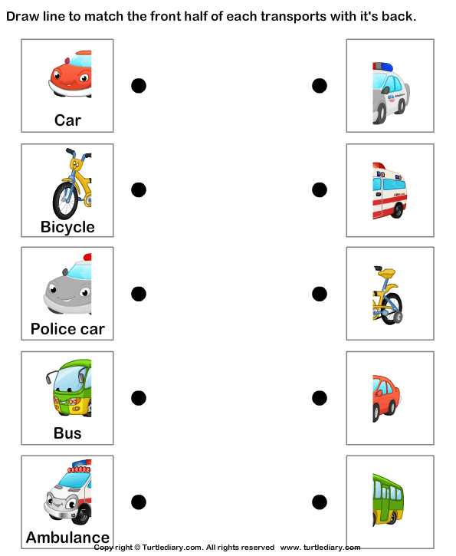

Slide 9
GROUP 2

Slide 10
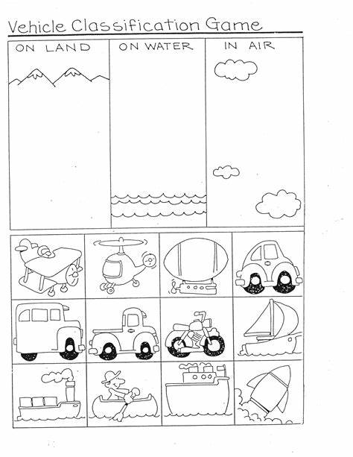

Slide 11
GROUP 3

Slide 12
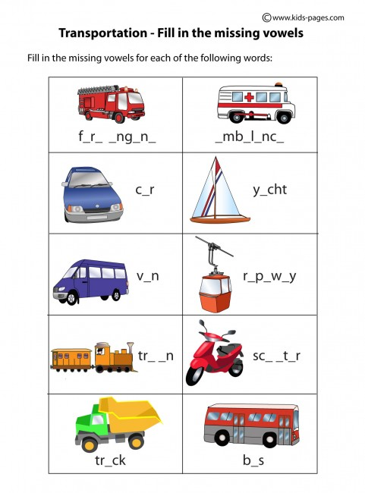

Slide 13
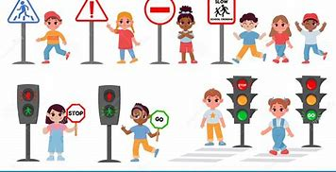
ROAD/ TRAFFIC SAFETY

Slide 14


Slide 15
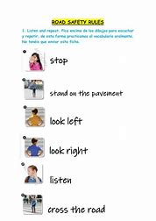

Slide 16
GROUP 1

Slide 17


Slide 18
GROUP 2

Slide 19
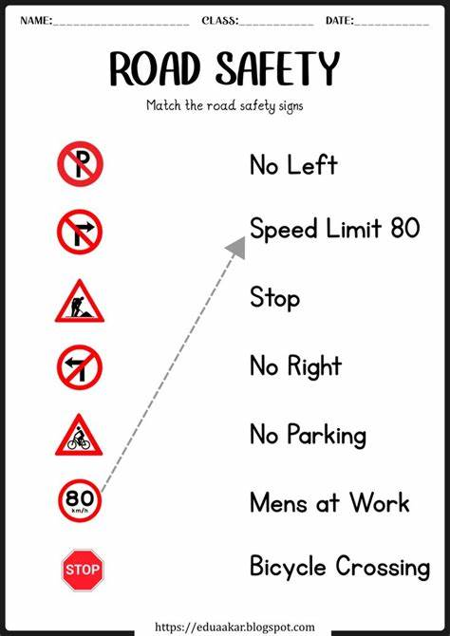

Slide 20
GROUP 3

Slide 21


Slide 22
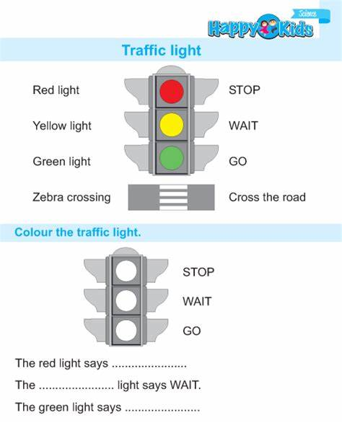

Slide 23

PEOPLE WHO HELP US

Slide 24
GROUP 1

Slide 25
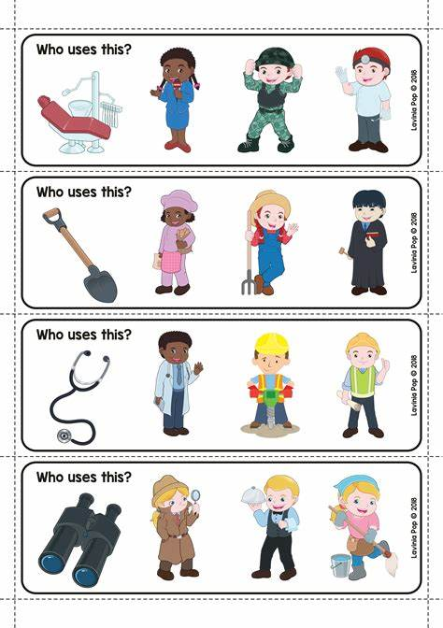

Slide 26
Group 2

Slide 27
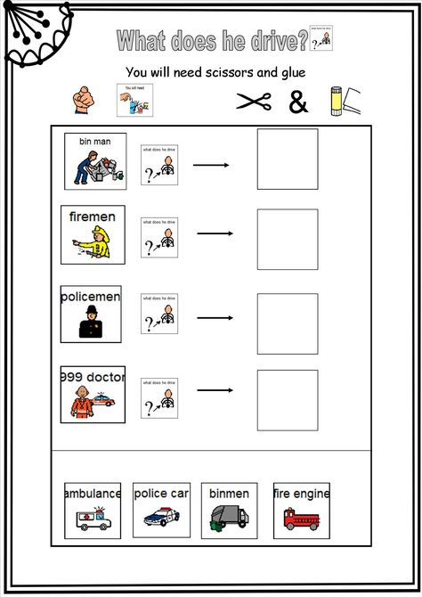

Slide 28
Group 3

Slide 29
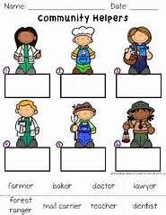

Slide 30
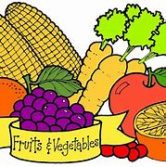
FRUIT AND VEGETABLES

Slide 31
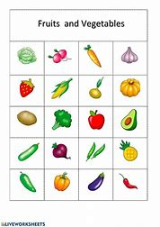

Slide 32
GROUP 1

Slide 33
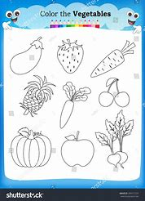

Slide 34
GROUP 2

Slide 35
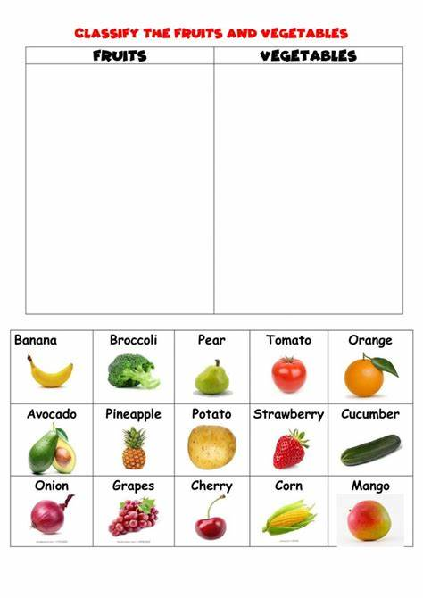

Slide 36
GROUP 3

Slide 37
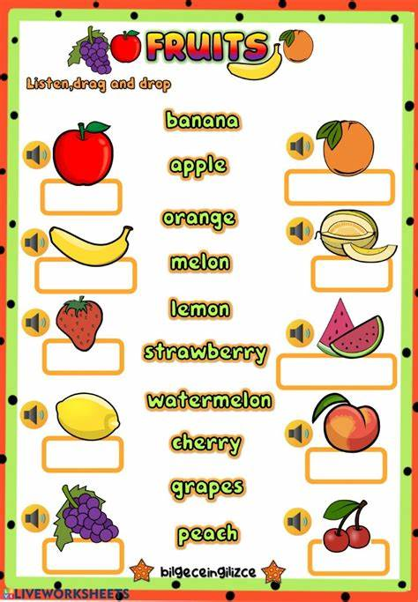

Slide 38
REFERENCES
https://cdn4.vectorstock.com/i/1000x1000/81/78/transport-cartoons-vector-598178.jpg
https://th.bing.com/th/id/R.4bedde0a34a46c3f8476e8a9c3193ea9?rik=HzmXgDwWSMiEgg&riu=http%3a%2f%2fcdn.turtlediary.com%2fworksheets%2fela%2fpreschool%2fmiscellaneous%2fland-transport-match-the-parts%2fquestion%2fland-transport-match-the-parts-1.png&ehk=QmUIA1EFbE4f0svBv4Cz5sxyTCRyjPK21lGTtr58rpw%3d&risl=&pid=ImgRaw&r=0
https://www.kids-pages.com/folders/worksheets/Transportation/TransportationFillIn.jpg
https://th.bing.com/th/id/OIP.fRSAqPJELZxVQ3CRL-bfpgAAAA?rs=1&pid=ImgDetMain
https://th.bing.com/th/id/OIP.j1aGQgbLnwFPQ_I9JjVwygHaKe?w=178&h=252&c=7&r=0&o=5&pid=1.7
https://th.bing.com/th/id/OIP.sfoXR83NPVP-oQz6Fw5fKgAAAA?w=178&h=241&c=7&r=0&o=5&pid=1.7
https://th.bing.com/th/id/OIP.Nf6VTxle16YtwHqxzvj24QAAAA?rs=1&pid=ImgDetMain
https://th.bing.com/th/id/OIP.G22CAwskSgcV--pN-tS4-gAAAA?rs=1&pid=ImgDetMain
https://i.pinimg.com/474x/8c/e3/85/8ce385035bc3affdf3f880752a62d2b2--people-who-help-us-activities-people-who-help-us-eyfs.jpg
https://th.bing.com/th/id/OIP.4dLKYDU8JIlA6pehEYnW1wAAAA?w=178&h=252&c=7&r=0&o=5&pid=1.7

Slide 39
REFERENCES
https://th.bing.com/th/id/OIP.7a0179VL3C9kPRM2vedC4wHaKN?w=178&h=246&c=7&r=0&o=5&pid=1.7
https://th.bing.com/th/id/OIP.VydevZbGqs48ggbXpXXr3QAAAA?rs=1&pid=ImgDetMain
https://th.bing.com/th/id/OIP.rCuRyffpd2A5GWu-FpGZyQAAAA?w=178&h=257&c=7&r=0&o=5&pid=1.7

